Slide 1

How contacting us online will change
The De Parys Group
comprises Cauldwell Medical Centre, Enhanced Services Centre, Pemberley Avenue, Church Lane, Bromham

Slide 2
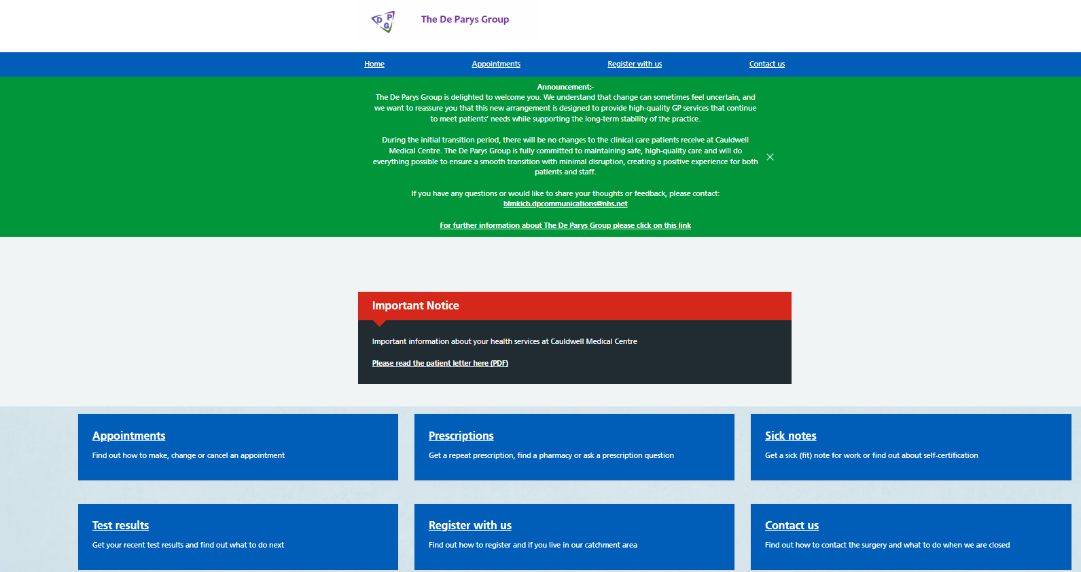
When you open the website
Initially the CMC website will remain the same.
Please select appointments / prescription etc.. As you currently do.

Slide 3
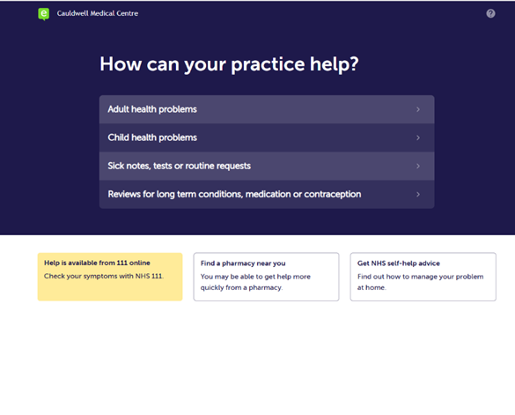
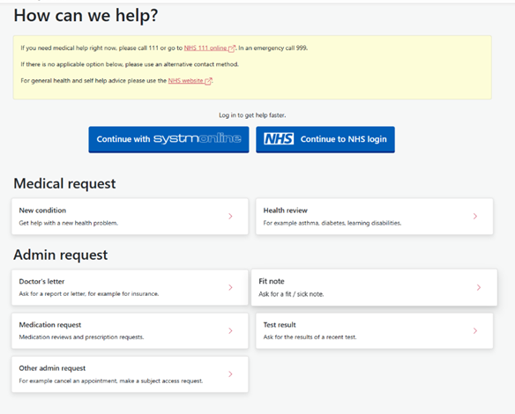
E-Consult
A slightly different platform
If you request an appointment/ Med 3/ prescription etc.. You will be directed to SystmConnect instead of E-Consult.
You will be asked a series of questions, like the E-Consult process.
SystmConnect sends your request to the right healthcare professional quickly and safely.
You can also choose to log into your NHS account and prepopulate some information like your date of birth.
SystmConnect

Slide 4
What if I find it hard to use?
There is a video link on the website where a patient walks you through how to use SystmConnect.
Patients can come to reception at any of our sites or call the appointment line for help.
We will be happy to complete the form on your behalf or to show you how to do it for next time.

